Slide 1

PREDICTION AND MONITORING OF MEDICAL STORAGE SYSTEM USING MACHINE LEARNING AND IOT
PRESENTATION BY -
DEVA GOPIKRISHNA PRASAD SIRIGIRI
SAI TEJA VENIGALLA

Slide 2
Table of contents
Abstract
Introduction
Objective of the Project
Architecture diagram
Modules Description
Conclusion
References

Slide 3

Abstract
This project intends to create a device that measures and predicts the quantity of oxygen required for future operations using a variety of machine learning algorithms.

Slide 4
Objective of the project
The project's main goal is to use several sensors such as a load cell, MQ2, MQ9, and LM35 to monitor oxygen levels, hazardous gas levels, and temperature in the medical storage.
These sensor values were sent to the ESP8266 module through Arduino, and if they were above or below the threshold limit, an SMS was sent to the maintainer.
Based on past operations data, multiple machine learning techniques such as Ridge, Lasso, OrdinaryLinerRegression, and MLP with ReLU are utilized to determine the quantity of oxygen that should be maintained for the registered operations.

Slide 5
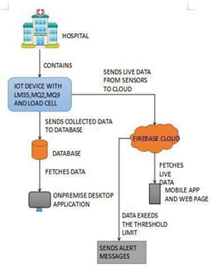
Architecture

Slide 6

Tools Used in the Project.
Visual studio version 2022 is used to build the desktop application.
Arduino IDE version 1.8.16 is used to code and deploy it to Arduino uno board and ESP8266.
Azure cloud and Google firebase is used for data management.
Visual Studio Code is used to implement multiple Machine Learning Techniques and to predict the oxygen quantity.
Android Studio is used to build android application.

Slide 7
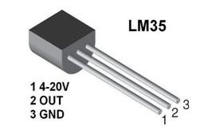
Modules description A. Temperature sensor
A. LM35 Temperature sensor :
The temperature was monitored using an LM35 sensor in this project. It detects temperatures between -55 and 150 degrees Celsius and communicates the information to the Arduino board using A0 pin.

Slide 8
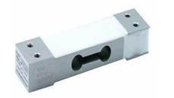
LOAD SENSOR
D. LOAD-CELL module:
The load cell is connected to Arduino using VCC, GND, Pin4, Pin5. This is used to get the oxygen quantity present in the hospital.

Slide 9
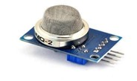
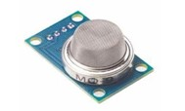
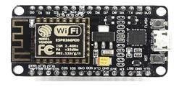
B. Sensors and WI-FI Module
MQ2 and MQ9 sensor :
The MQ2 and MQ9 sensors are used to detect various harmful gases and relay the information to the Arduino board using A2 and A1 respectively.
ESP8266-WIFI module :
ESP8266 is connected to Arduino using RX, TX, VCC, GND pins. The data from the sensors is delivered via an ESP8266 Wi-Fi module from Arduino to the Azure Cloud. In the event that sensor data reached critical levels, SMS was sent from the ESP8266 module to the storage maintainer via an SMS gateway.
Mq2 sensor
Mq9 sensor
esp8266

Slide 10
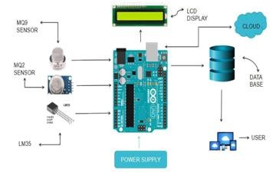
Hardware Connections
Figure represents the connection between LM35,MQ2 and MQ9 sensors to the Arduino.
And connectivity of Arduino to the Microsoft SQL data base and firebase cloud using ESP8266 Wi-Fi module.

Slide 11
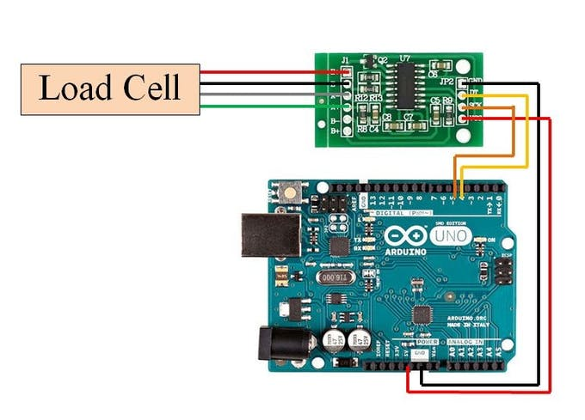
Wi-Fi Module Connection’s
Load Cell as four colored wires :
Red connected to E+,
Black connected to E-,
White connected to A+,
Green connected to A-.
Arduino Connections :
Ground to Arduino Ground,
Vcc to Arduino Vcc,
Digital IO Connection to 4th pin of Arduino,
Clock Pin to 5th pin of Arduino.

Slide 12
Hardware Connection
LM35(TEMPERATURE SENSOR) :
Analog Pin connected to A0 anolog pin of arduino, where data transmission occurs.
MQ2 and MQ9 Sensor’s :
MQ2 and MQ9 are connected to the A2 and A3 pins of arduino.
Three sensor’s LM35,MQ2 and MQ9 has voltage pin and ground pin, connected to Arduino Vcc , Gnd.
Sensed data from the ardunio was collected through the rx and tx pins of arduino to node mcu(Node Micro-Controller Unit).
The data collected to the Azure using nodemcu.

Slide 13
Hardware Details

Slide 14
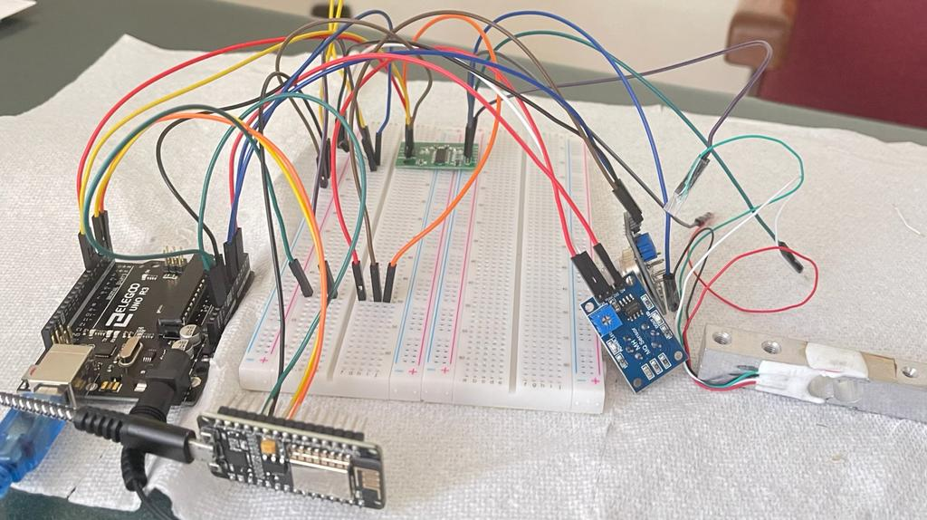

Slide 15
Software Details

Slide 16

DeskTop Application

Slide 17
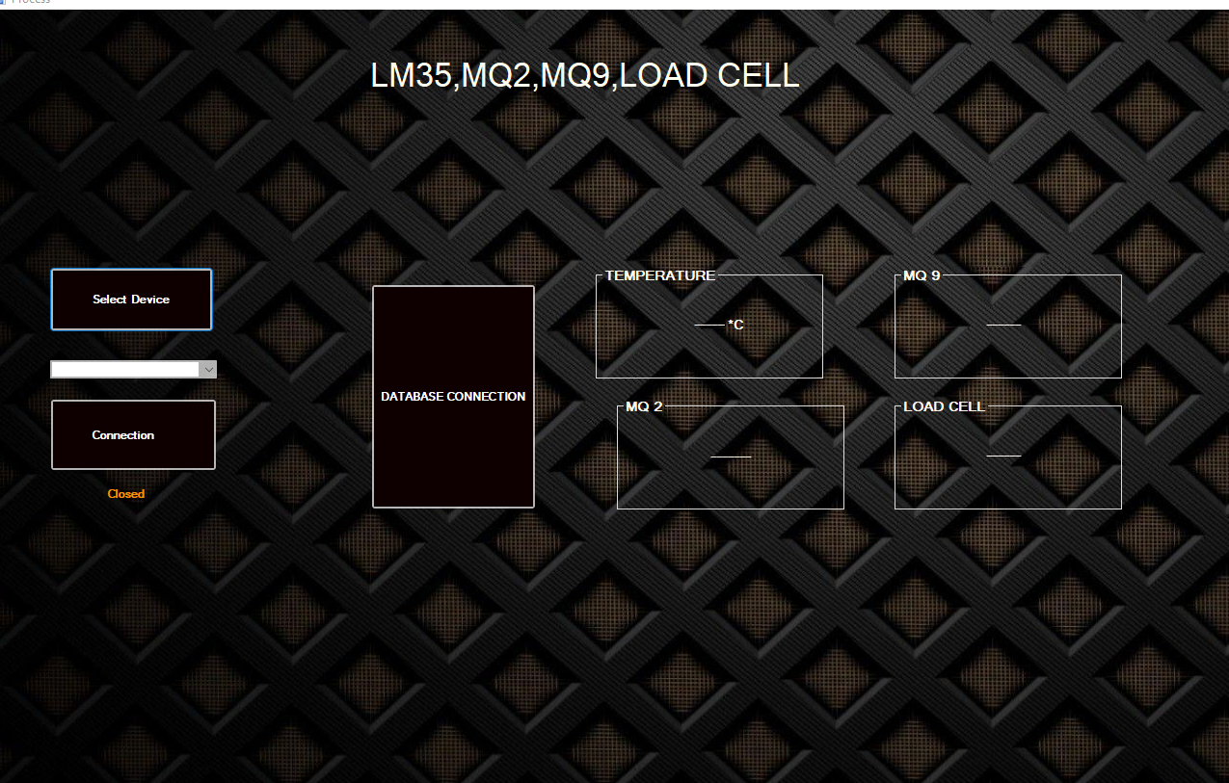
Cont..

Slide 18
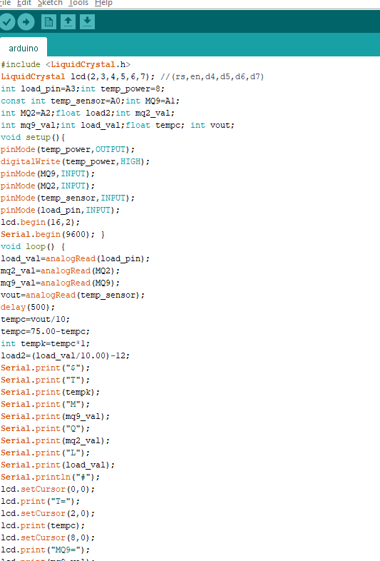
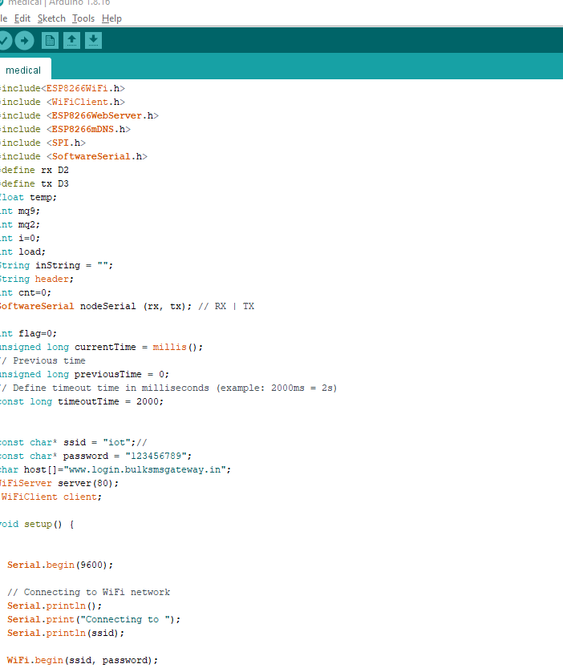
Arduino

Slide 19
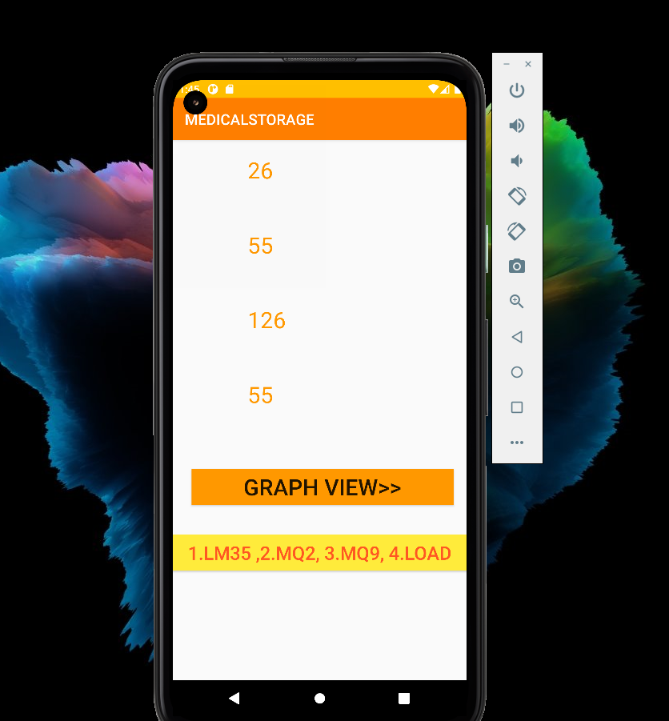
Android Application

Slide 20
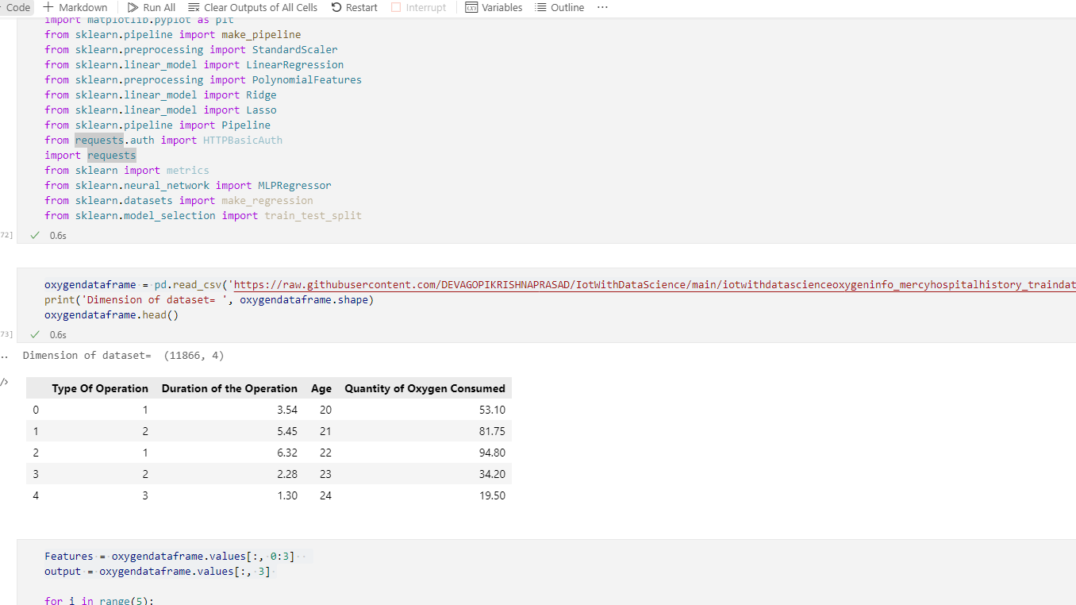
Machine Learning Algorithms

Slide 21
CONCLUSION
It's challenging to keep the hospital's oxygen cylinders in good condition. We utilized prediction algorithm to anticipate the amount of oxygen that should be kept for future registered operations in order to sustain the oxygen cylinders.
The goal of this project was to develop a low-cost mechanism for monitoring and forecasting the oxygen storage system and we achieved the goal.

Slide 22
References
Asrul Adam, Ibrahim Shapiai, Marzuki Khalid," A modified Artificial neural network algorithm for imbalanced data set problem "2010 Second International Conference on Computational Intelligence, Communication Systems and Networks.
Mr. Nerella Ome1, Mr. G. Someswara Rao2,"Internet of Things (IoT) based Sensors to Cloud system using ESP8266 and Arduino Due"International Journal of Advanced Research in Computer and Communication Engineering.
Rudrendu Mahindar1, Madhav Prakash2, Sananda Ghosh3, Sumani Mukherjee4 andDr. Rabindranath Ghosh5,"IoT-based Home Appliances Control System Using NodeMCU and Blynk Server"International Advanced Research Journal in Science, Engineering and Technology.

Slide 23


Slide 24

THANK YOU

